Slide 1
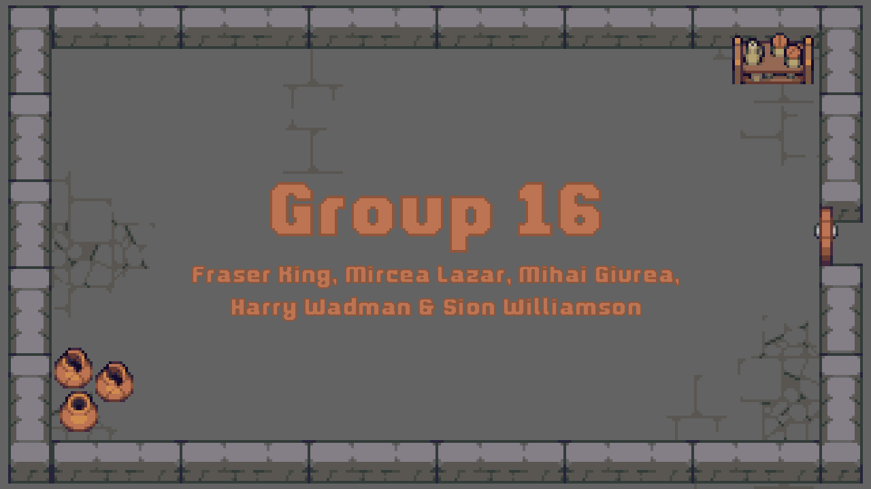

Slide 2

What are the Key Requirements of the Brief?
Single-player game
Removal of a core mechanic(s) associated with any given genre
Innovative solution to the unique design challenges presented with the removal of this mechanic

Slide 3
Brief Solution
Selected Genre
‘Run and Gun’ Roguelike
Traditional Core Mechanics
Procedurally Generated Levels
No Permanence Between ‘Runs’
Free movement, typically fixed on 4 to 8 axis basis
Traditional ‘free’ movement replaced with kickback on-shoot
What happens if you pull the ‘run’ out of a ‘run and gun’?

Slide 5
Kickback Mechanic
Provides new risk/reward dynamic not typically seen in run and gun roguelikes
Optimise movement vs Focus on killing enemies
Neatly creates a new set of unique design challenges to facilitate the “creative solutions” and “promotion of distinct game designs” outlined in the brief
Examples include balancing room design to accommodate for revised movement and designing enemies/environmental hazards that utilize the core mechanic in interesting and fair ways

Slide 6
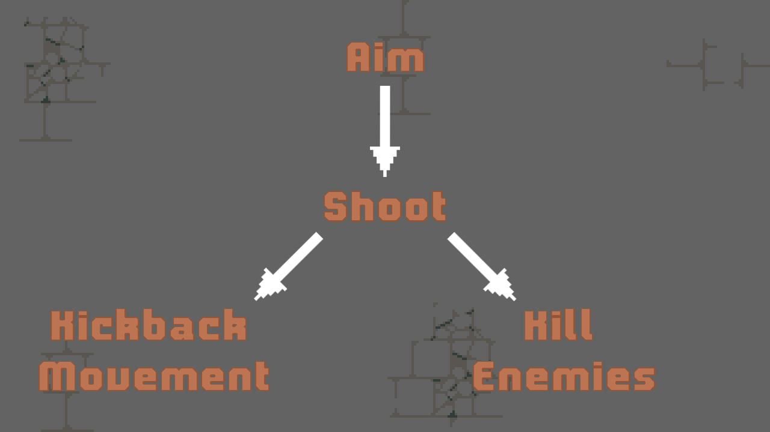

Slide 7
Desired Player Emotions
Fiero
Fiero expressed as relief from Dramatic Tension reaching climax and eventual conclusion
Flow
Unique challenge posed by core game loop mixed alongside the curated design of procedurally generated rooms wraps player in a state of flow
Anticipatory Surprise
Player anticipates positive surprise through curiosity-driven exploration of proc-gen dungeon

Slide 8
Video of MVP

Slide 9
Week 12 Deliverables
Fully Implemented Procedural-Dungeon System
Inclusive of 20+ hand curated dungeon rooms
2 – 4 varied AI controllers, driving a range of modular enemies
Numerous ‘Game Feel’ scripts implemented (e.g. Screen-shake, Pause On-Hit etc…)
Full implementation of dungeon, character and weapon assets
A playtested, iterated and generally polished core mechanic

Slide 10
